Slide 1
CCSK 01
Cloud Computing Concepts and Architectures
Resp: Leonardo Santos Silva

Slide 2
00 - Introduction
Benefits in agility, resiliency, and economy.
Organizations can:
Move faster (since they don’t have to purchase and provision hardware, and everything is software defined),
Reduce downtime (thanks to inherent elasticity and other cloud characteristics),
Save money (due to reduced capital expenses and better demand and capacity matching).
Security benefits since cloud providers have significant economic incentives to protect customers.
Understand and adopt cloud-native models and adjust your architectures and controls to align with the features and capabilities of cloud platforms. In fact, taking an existing application or asset and simply moving it to a cloud provider without any changes will often reduce agility, resiliency, and even security, all while increasing costs.
Taxonomy:
NIST SP800-145
ISO/IEC 17788
ISO/IEC 17789

Slide 3
01 – Overview - Defining Cloud Computing
Cloud computing is a new operational model and set of technologies for managing shared pools of computing resources.
NIST: Cloud computing is a model for enabling ubiquitous, convenient, on-demand network access to a shared pool of configurable computing resources (e.g., networks, servers, storage, applications, and services) that can be rapidly provisioned and released with minimal management effort or service provider interaction.
ISO/IEC: Paradigm for enabling network access to a scalable and elastic pool of shareable physical or virtual resources with self-service provisioning and administration on-demand
Cloud user (Client, Consumer) is the person or organization requesting and using the resources,
Cloud provider (Service, Cloud, CSP) is the person or organization who delivers it.
NIST 500-292 uses the term “cloud actor” and adds roles for cloud brokers, carriers, and auditors.
ISO/IEC 17788 uses the terms cloud service customer (CSC), cloud service partner, and cloud service provider (CSP).
Abstract the resources from the underlying physical infrastructure to create our pools, and use orchestration (and automation) to coordinate carving out and delivering a set of resources from the pools to the consumers: all the essential characteristics we use to define something as a “cloud.”
Clouds are multitenant by nature. Multiple different consumer constituencies share the same pool of resources but are segregated and isolated from each other. Segregation allows the cloud provider to divvy up resources to the different groups, and isolation ensures they can’t see or modify each other’s assets. Multitenancy doesn’t only apply across different organizations; it’s also used to divvy up resources between different units in a single business or organization

Slide 4
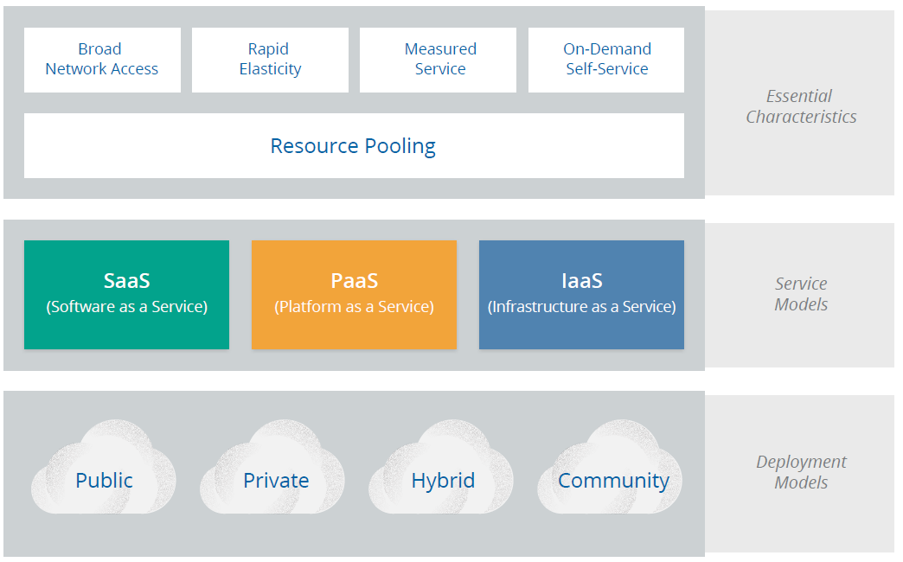
01 – Overview - Definitional Model
NIST: 5 essential characteristics (+multitenancy for ISO/IEC 17788), 3 cloud service models, and 4 cloud deployment models.
all resources are available over a network, without any need for direct physical access; (the network is not necessarily part of the service)
They manage their resources themselves, without having to talk to a human administrator
Abstracts resources and collects them into a pool, portions of which can be allocated to different consumers
Ensure that consumers only use what they are allotted, and, if necessary, to charge them for it.
allows consumers to expand or contract the resources they use from the pool (provisioning and deprovisioning), often completely automatically

Slide 5
01 – Overview - Definitional Model
NIST: 5 essential characteristics (+multitenancy for ISO/IEC 17788), 3 cloud service models, and 4 cloud deployment models.
Offers access to a resource pool of fundamental computing infrastructure, such as compute, network, or storage
Abstracts and provides development or application platforms, you don’t manage the underlying servers, networks, or other infrastructure.
Full application that’s managed and hosted by the provider. Consumers access it with a web browser, mobile app, or a lightweight client app

Slide 6
01 – Overview - Definitional Model
NIST: 5 essential characteristics (+multitenancy for ISO/IEC 17788), 3 cloud service models, and 4 cloud deployment models.
Shared by several organizations and supports a specific community that has shared concerns
Operated solely for a single organization. It may be managed by the organization or by a 3rd party
The cloud infrastructure is made available to the general public/large industry group and is owned by an organization selling cloud services
Composition of 2 or more clouds that remain unique entities but are bound together by standardized or proprietary technology

Slide 7
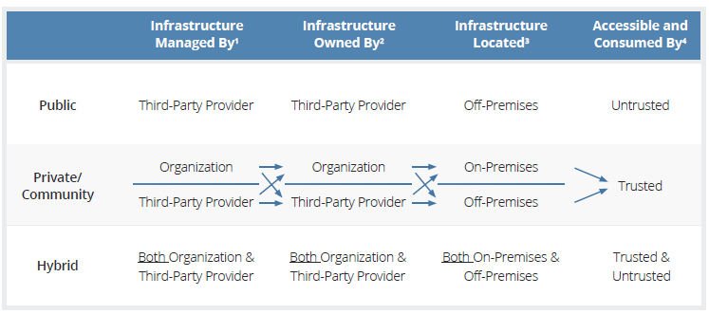
01 – Overview - Definitional Model
Notes:
1 Management includes: governance, operations, security, compliance, etc...
2 Infrastructure implies physical infrastructure such as facilities, compute network and storage equipment
3 Infrastructure location is both physical relative to an organization’s management umbrella and speaks to ownership versus control
4 Trusted consumers of service are those who are considered part of an organization’s legal/contractual/policy umbrella including employees, contractors, and business partners. Untrusted consumers are those that may be authorized to consume some/all services but are not logical extensions of the organization.

Slide 8
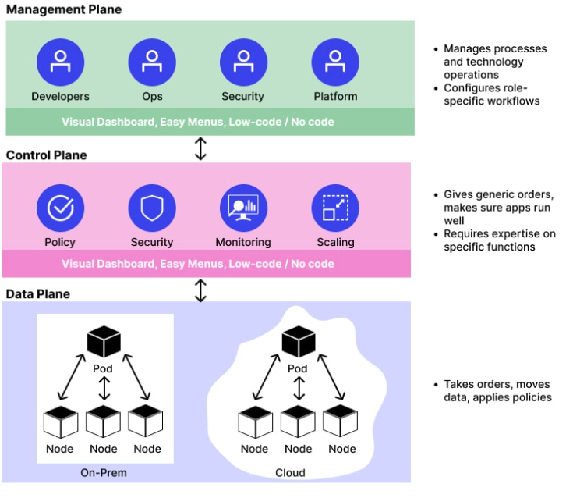
01 – Overview – Planes (Extra)
Management plane – Provisionar, configurar, deprovisionar todos os recursos para os clients de um CSP (exposição de interfaces northbound, de acordo com o padrão SDP)
Control Plane – conecta os recursos provisionados a cada um deles em redes segregadas de acordo com cada tenant (interfaces southbound: controle das funções de rede)
Data Plane – Transfere dados de e para um tenant específico para as VMs e Recursos (infraestrutura)
Notes:
Fonte: https://www.wallarm.com/what/what-is-the-control-plane

Slide 9
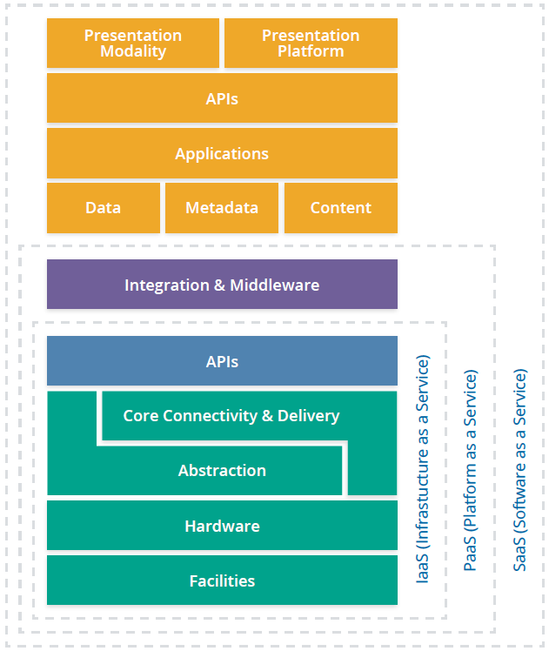
01 – Overview - Reference and Architecture Models- IaaS
Resources are pooled using abstraction and orchestration. Abstraction, often via virtualization, frees the resources from their physical constraints to enable pooling. Then a set of core connectivity and delivery tools (orchestration) ties these abstracted resources together, creates the pools, and provides the automation to deliver them to customers.
All this is facilitated using APIs (are typically the underlying communications method for components within a cloud, some of which or an entirely different set) are exposed to the cloud user to manage their resources and configurations. API use REST (Representational State Transfer), → runs over the HTTP protocol, making it extremely well suited for Internet services.
APIs are both remotely accessible and wrapped into a web-based user interface. This combination is the cloud management plane, since consumers use it to manage and configure the cloud resources. From a security perspective, it is both the biggest difference from protecting physical infrastructure (since you can’t rely on physical access as a control) and the top priority when designing a cloud security program. If an attacker gets into your management plane, they potentially have full remote access to your entire cloud deployment.
IaaS consists of a facility, hardware, an abstraction layer, an orchestration (core connectivity and delivery) layer to tie together the abstracted resources, and APIs to remotely manage the resources and deliver them to consumers.

Slide 10
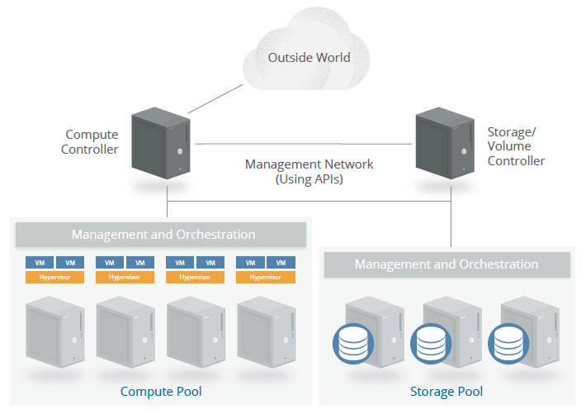
01 – Overview - Reference and Architecture Models
Notes:
A series of physical servers each run two components: a hypervisor (for virtualization) and the management/orchestration software to tie in the servers and connect them to the compute controller. A customer asks for an instance (virtual server) of a particular size and the cloud controller determines which server has the capacity and allocates an instance of the requested size. The controller then creates a virtual hard drive by requesting storage from the storage controller, which allocates storage from the storage pool, and connects it to the appropriate host server and instance over the network (a dedicated network for storage traffic). Networking, including virtual
network interfaces and addresses, is also allocated and connected to the necessary virtual network.
The controller then sends a copy of the server image into the virtual machine, boots it, and configures it; this creates an instance running in a virtual machine (VM), with virtual networking and storage all properly configured. Once this entire process is complete, the metadata and connectivity information is brokered by the cloud controller and available to the consumer, who can now connect to the instance and log in.

Slide 11
01 – Overview - Reference and Architecture Models
PaaS
PaaS is the hardest to definitively characterize due to both the wide range of PaaS offerings and the many ways of building PaaS. PaaS adds an additional layer of integration with application development frameworks, middleware capabilities, and functions such as databases, messaging, and queuing. These services allow developers to build applications on the platform with programming languages and tools that are supported by the stack.
One option, frequently seen in the real world, is to build a platform on top of IaaS. A layer of integration and middleware is built on IaaS, then pooled together, orchestrated, and exposed to customers using APIs as PaaS.
In PaaS the cloud user only sees the platform, not the underlying infrastructure. In our example, the database expands (or contracts) as needed based on utilization, without the customer having to manage individual servers, networking, patches, etc.

Slide 12
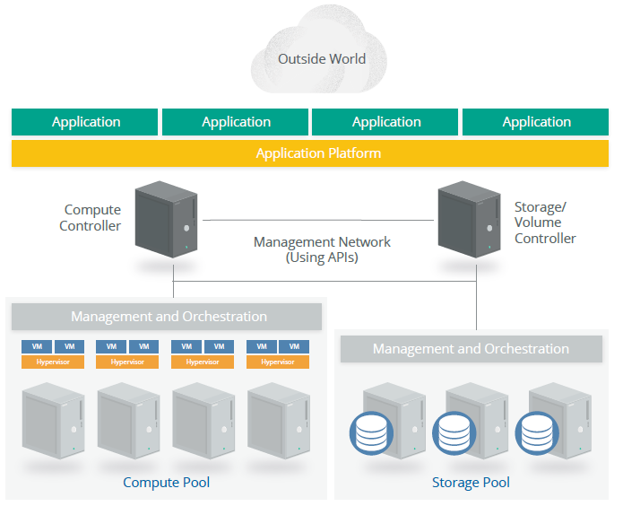
01 – Overview - Reference and Architecture Models
Notes:
PaaS doesn’t necessarily need to be built on top of IaaS; there is no reason it cannot be a custom designed stand-alone architecture. The defining characteristic is that consumers access and manage the platform, not the underlying infrastructure (including cloud infrastructure).

Slide 13
01 – Overview - Reference and Architecture Models
SaaS
SaaS services are full, multitenant applications, with all the architectural complexities of any large software platform. Many SaaS providers build on top of IaaS and PaaS due to the increased agility, resilience, and (potential) economic benefits.
Most modern cloud applications (SaaS or otherwise) use a combination of IaaS and PaaS, sometimes across different cloud providers. Many also tend to offer public APIs for some (or all) functionality. They often need these to support a variety of clients, especially web browsers and mobile apps.
Thus all SaaS tends to have an application/logic layer and data storage, with an API on top. Then there are one or more presentation layers, often including web browsers, mobile applications, and public API access.

Slide 14
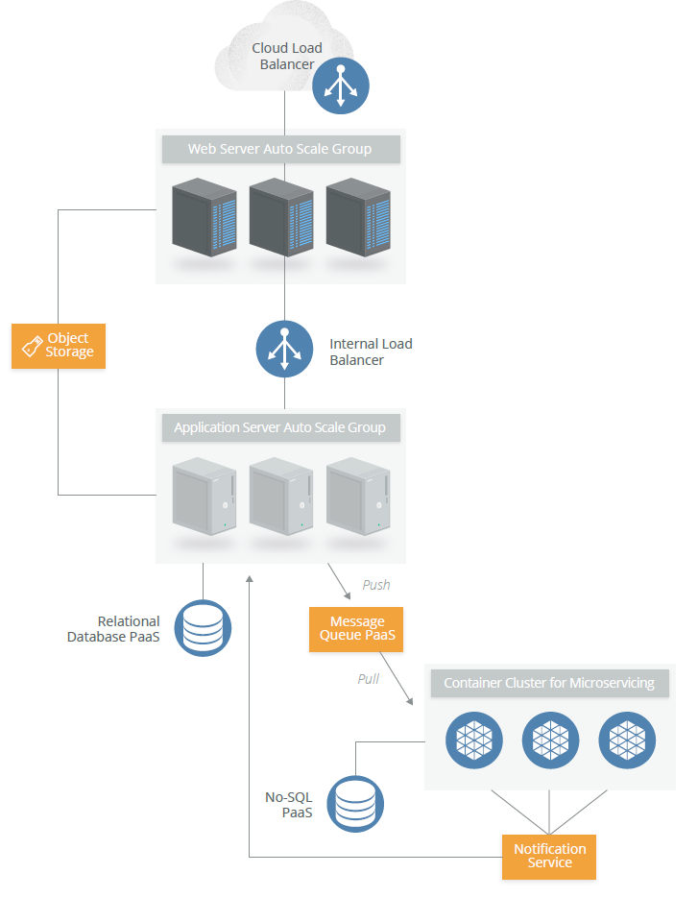
01 – Overview - Reference and Architecture Models

Slide 15
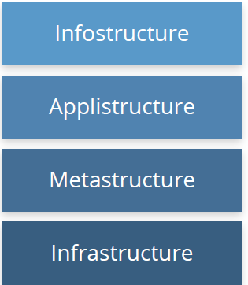
01 – Overview – Logical Model
Different layers based on functionality
The data and information. Content in a database, file storage, etc.
The applications deployed in the cloud and the underlying application services used to build them. For example, Platform as a Service features like message queues, artificial intelligence analysis, or notification services
The key difference between cloud and traditional
→ includes the management plane components, which are network-enabled and remotely accessible.
→ in cloud, you tend to double up on each layer. Infrastructure, for example, includes both the infrastructure used to create the cloud + virtual infrastructure used and managed by the cloud user.
In private cloud, the same organization might need to manage both; in public cloud the CSP manages the physical infrastructure while the consumer manages their portion of the virtual infrastructure.
The protocols and mechanisms that provide the interface between the infrastructure layer and the other layers. The glue
The core components of a computing system: compute, network, and storage. The foundation that everything else is built on. The moving parts

Slide 16
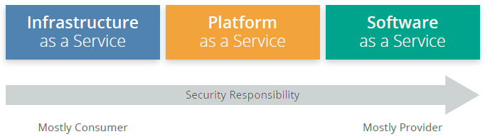
02 – Cloud Security Scope, Responsibilities, and Models - Responsibilities
All the traditional security domains remain, but the nature of risks, roles and responsibilities, and implementation of controls change, often dramatically
shared responsibility model
SaaS: The cloud provider is responsible for nearly all security, since the cloud user can only access and manage their use of the application and can’t alter how the application works.
PaaS: The cloud provider is responsible for the security of the platform, while the consumer is responsible for everything they implement on the platform, including how they configure any offered security features. The responsibilities are thus more evenly split.
IaaS: Just like PaaS, the provider is responsible for foundational security, while the cloud user is responsible for everything they build on the infrastructure. Unlike PaaS, this places far more responsibility on the client.

Slide 17
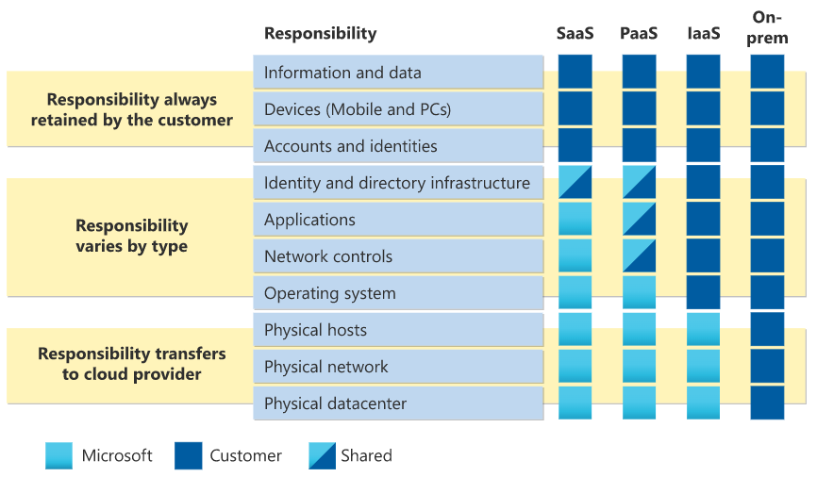
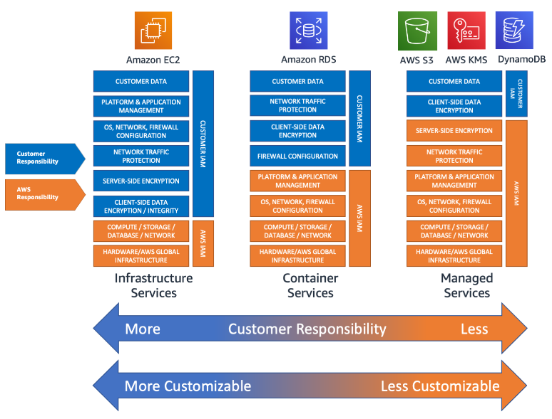
02 – Cloud Security Scope, Responsibilities, and Models - Responsibilities
Notes:
Azure SRM: https://learn.microsoft.com/pt-br/azure/security/fundamentals/shared-responsibility
AWS SRM: https://aws.amazon.com/pt/blogs/industries/applying-the-aws-shared-responsibility-model-to-your-gxp-solution/

Slide 18
02 – Cloud Security Scope, Responsibilities, and Models - Responsibilities
The most important security consideration is knowing exactly who is responsible for what in any given cloud project. It’s less important if any particular cloud provider offers a specific security control, as long as you know precisely what they do offer and how it works. You can fill the gaps with your own controls or choose a different provider if you can’t close the controls gap. Your ability to do this is very high for IaaS, and less so for SaaS
What does the provider do?
What does the consumer need to do?
Does the cloud provider enable the consumer to do what they need to?
What is guaranteed in the contract and service level agreements, and what is implied by the documentation and specifics of the technology?
CSP
document their internal security controls and customer security features so the cloud user can make an informed decision. Providers should also properly design and implement those controls
Users
for any given cloud project, build a responsibilities matrix to document who is implementing which controls and how. This should also align with any necessary compliance standards
Consensus Assessments Initiative Questionnaire (CAIQ)
standard template for cloud providers to document their security and compliance controls.
Cloud Controls Matrix (CCM)
cloud security controls and maps them to multiple security and compliance standards. The CCM can also be used to document security responsibilities

Slide 19
02 – Cloud Security Scope, Responsibilities, and Models –Security Models
Conceptual models or frameworks
include visualizations and descriptions used to explain cloud security concepts and principles, such as the CSA logical model in this document
Control models or frameworks
categorize and detail specific cloud security controls or categories of controls, such as the CSA CCM.
Reference architectures
templates for implementing cloud security, typically generalized (e.g. an IaaS security reference architecture). They can be very abstract, bordering on conceptual, or quite detailed, down to specific controls and functions
Design patterns
are reusable solutions to particular problems. In security, an example is IaaS log management. As with reference architectures, they can be more or less abstract or specific, even down to common implementation patterns on particular cloud platforms..

Slide 20
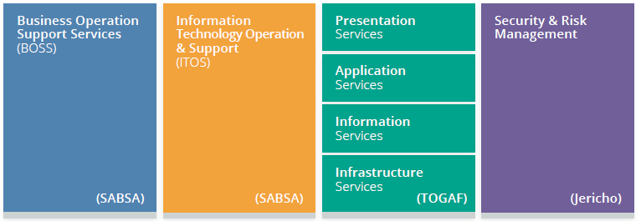
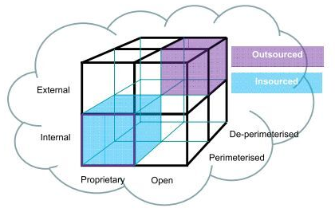
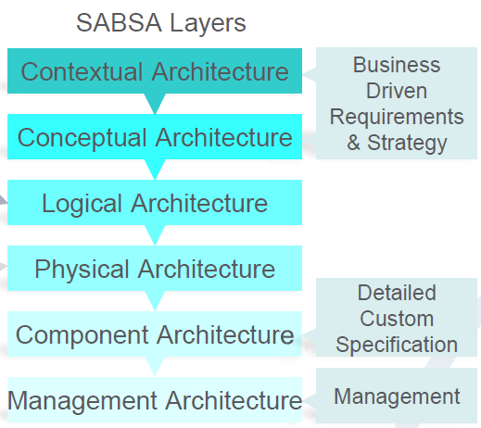
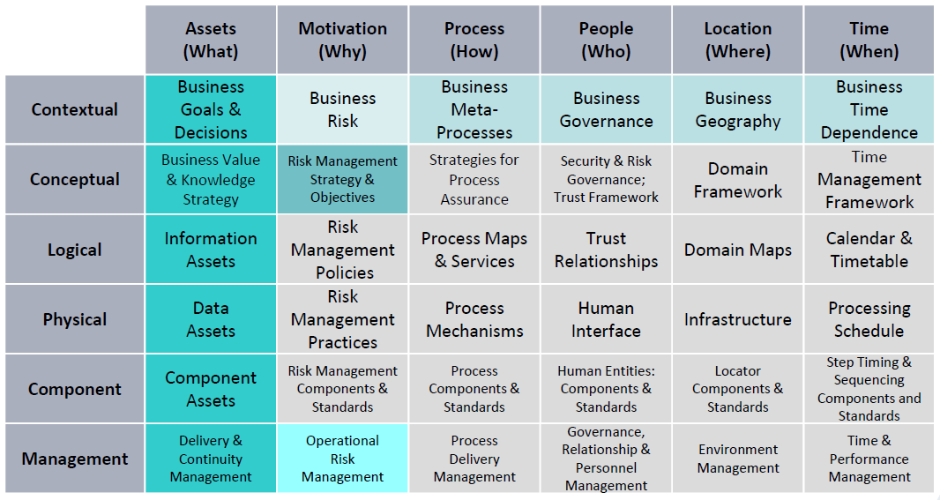
02 – Cloud Security Scope, Responsibilities, and Models - Security Models
The CSA has reviewed and recommends the following models:
The CSA Enterprise Architecture
The CSA Cloud Controls Matrix
The NIST draft Cloud Computing Security Reference Architecture (NIST Special Publication 500-299), which includes conceptual models, reference architectures, and a controls framework.
ISO/IEC FDIS 27017 Information technology – Security techniques – Code of practice for information security controls based on ISO/IEC 27002 for cloud services.
+ ZTA

Slide 21
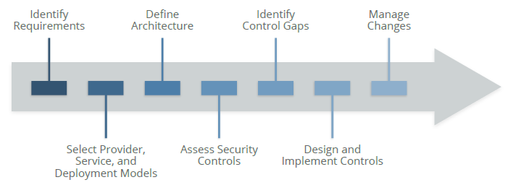
02 – Cloud Security Scope, Responsibilities, and Models - Security Models
High-level process for managing cloud security:
Need to know the cloud provider and architecture before you start translating security requirements into controls
Notes:
Identify necessary security and compliance requirements, and any existing controls.
Select your cloud provider, service, and deployment models.
Define the architecture.
Assess the security controls.
Identify control gaps.
Design and implement controls to fill the gaps.
Manage changes over time.

Slide 22
03 – Areas of Critical Focus
Governance Domains: Broad and address strategic and policy issues within a cloud computing environment
Operational Domains: tactical security concerns and implementation within the architecture
Management Plane and Business Continuity
Infrastructure Security
Governance and Enterprise Risk Management
Virtualization and Containers
Incident Response, Notification and Remediation
Legal Issues: Contracts and Electronic Discovery
Application Security
Data Security and Encryption
Compliance and Audit Management
Identity, Entitlement, and Access Management
Security as a Service
Information Governance
Related Technologies

Slide 23
04 – Recommendations
Understand the differences between cloud computing and traditional infrastructure or virtualization, and how abstraction and automation impact security.
Become familiar with the NIST model for cloud computing and the CSA reference architecture.
Use tools such as the CSA Consensus Assessments Initiative Questionnaire (CAIQ) to evaluate and compare cloud providers.
Cloud providers should clearly document their security controls and features and publish them using tools like the CSA CAIQ.
Use tools like the CSA Cloud Controls Matrix to assess and document cloud project security and compliance requirements and controls, as well as who is responsible for each.
Use a cloud security process model to select providers, design architectures, identify control gaps, and implement security and compliance controls.

Slide 24
End of Domain 01

